Slide 1
Deposition Rate Optimization; Thin-Film
Technical Presentation for SensArray Division
Varad Lad | Mechanical Manufacturing Design Engineer

Slide 2
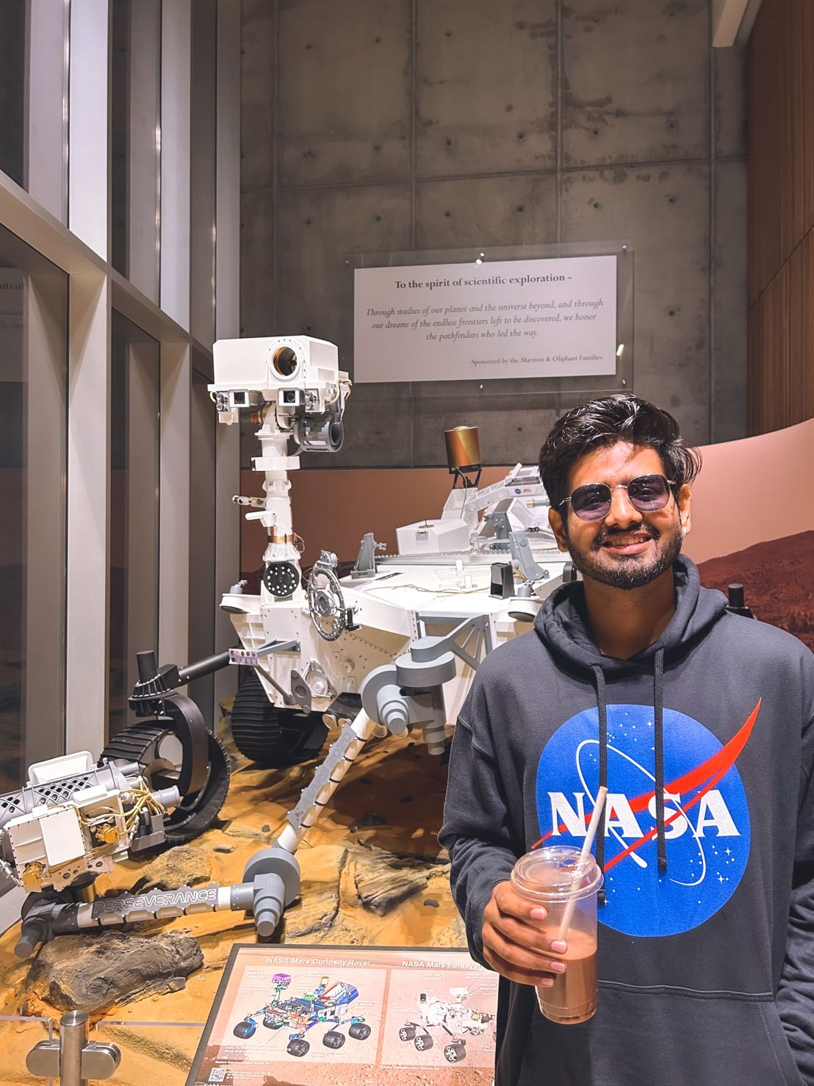
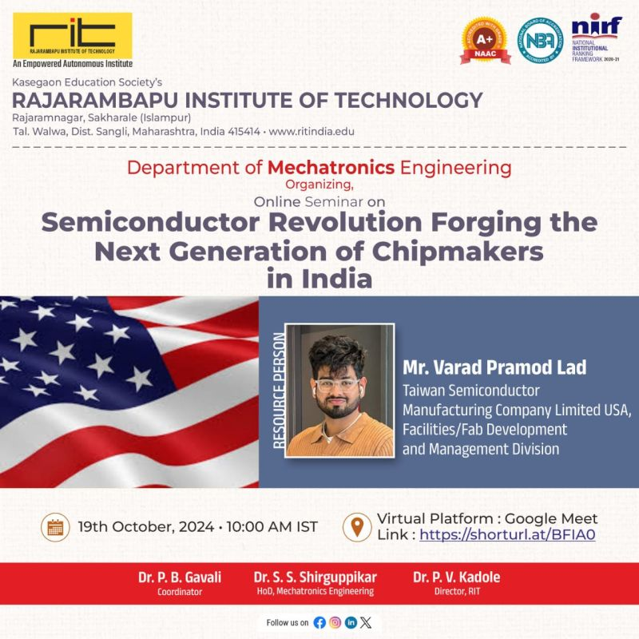
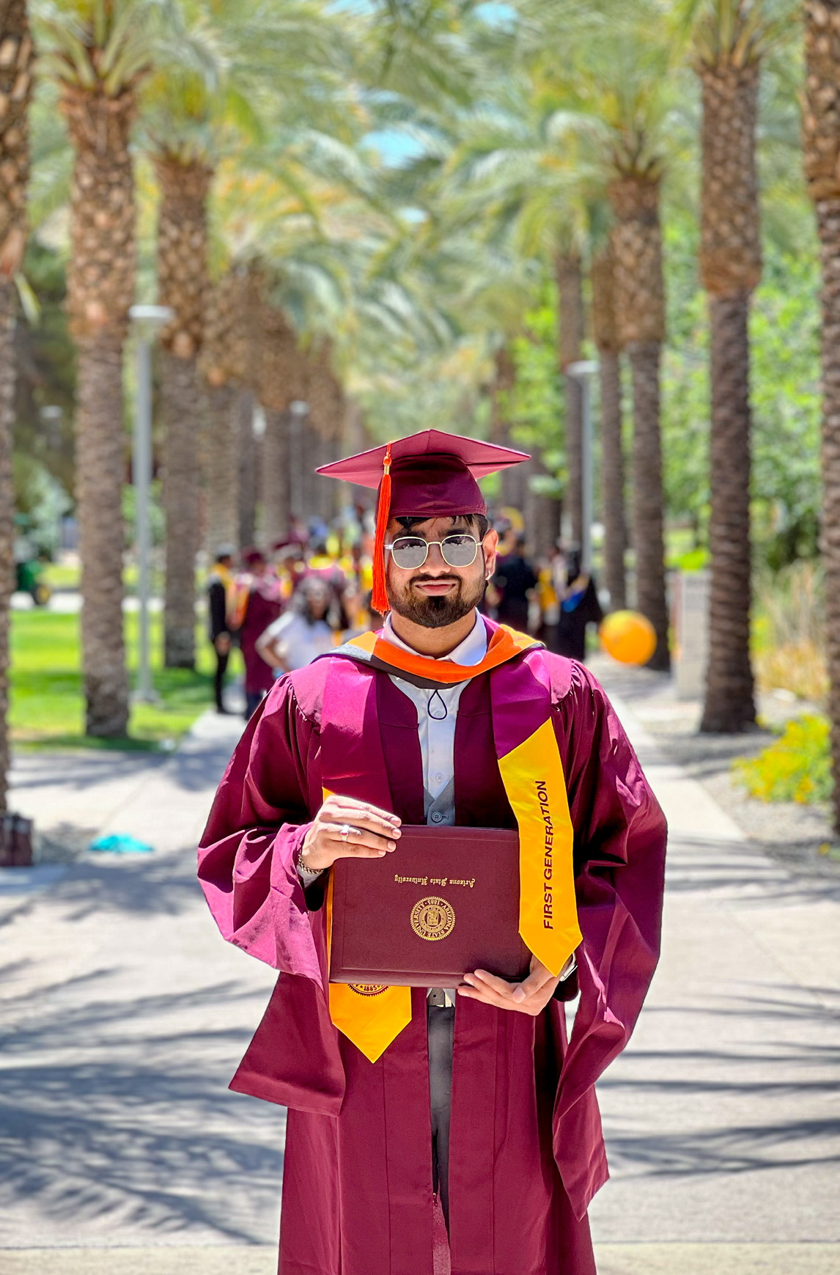
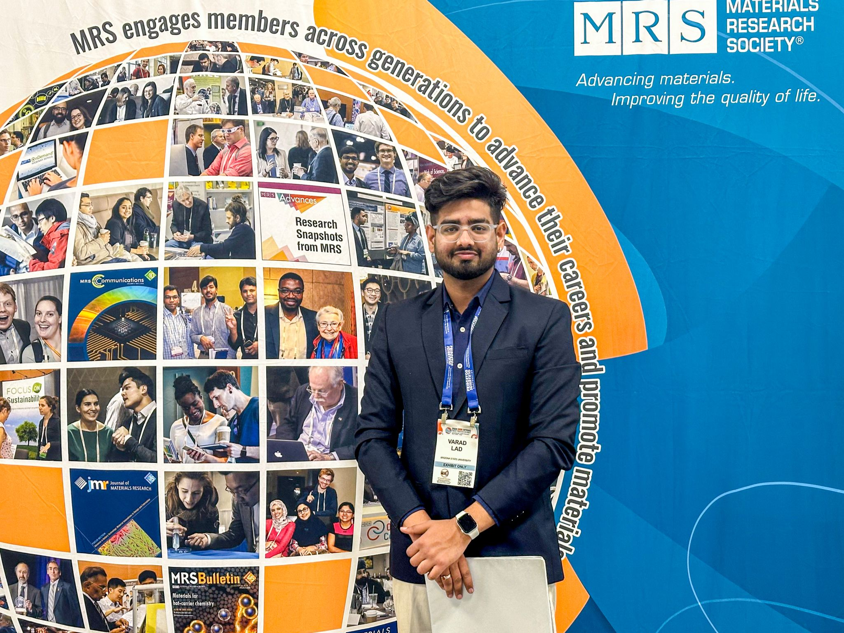
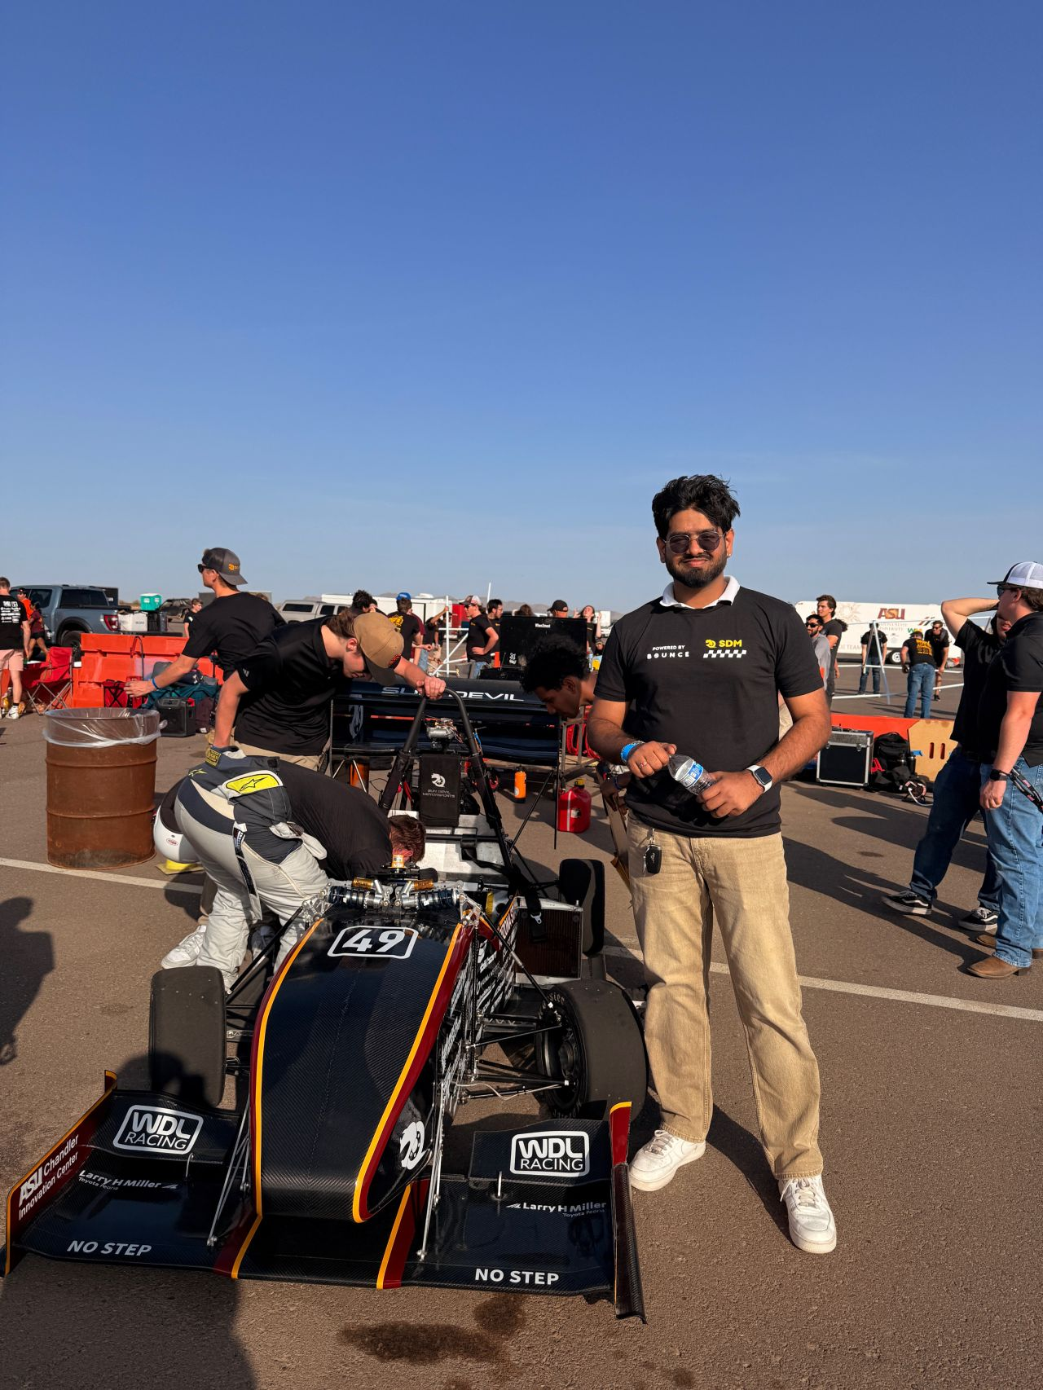
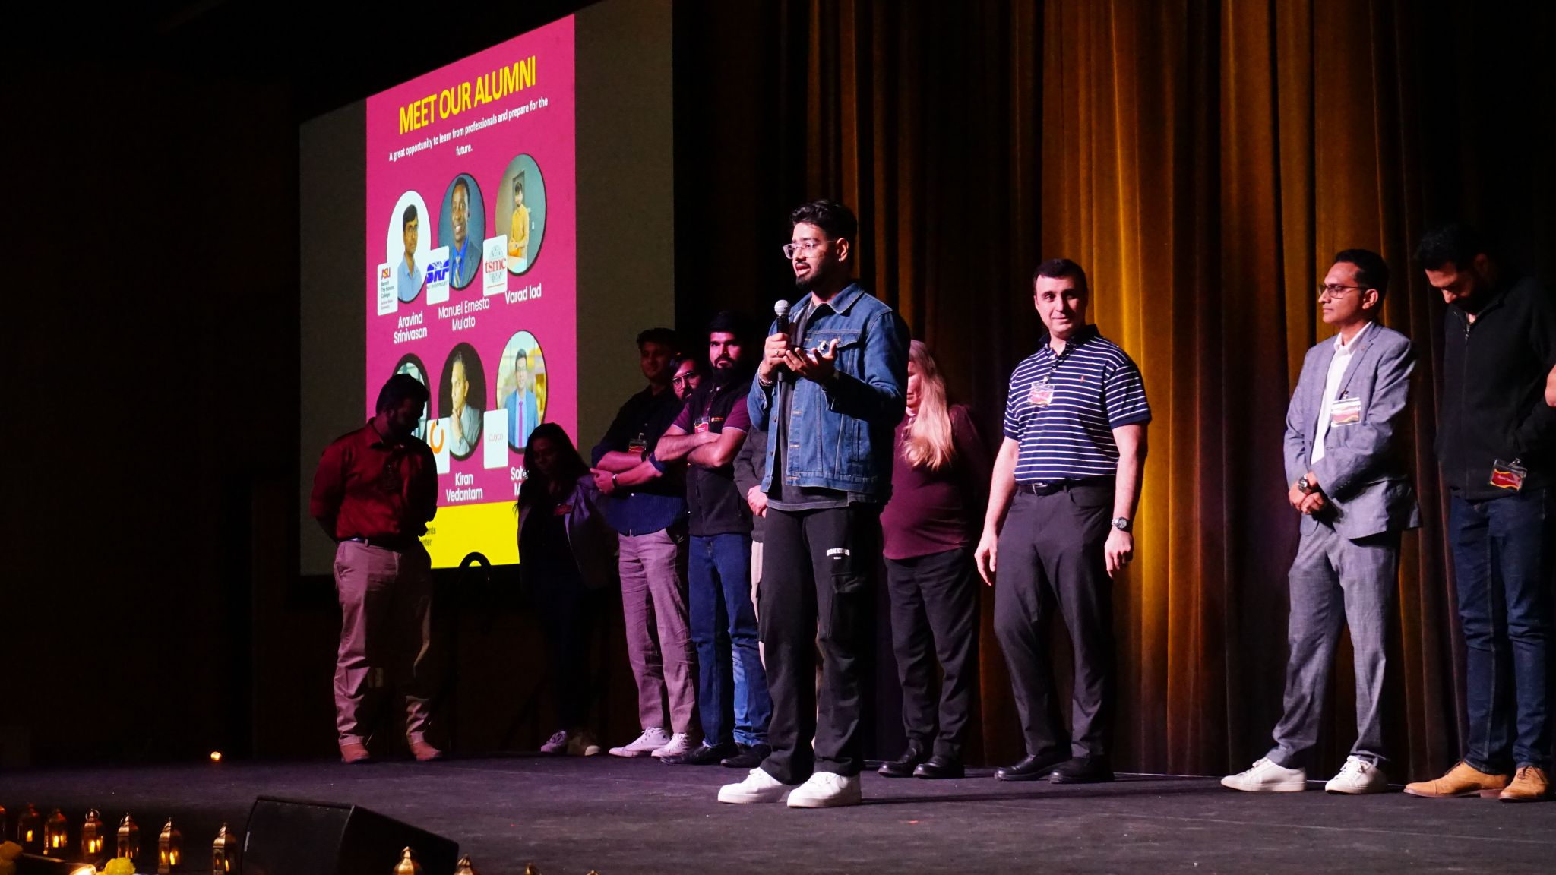
Introduction & Background
Varad Lad, MS in Mechanical Engineer at Arizona State University
5 years across Mechanical & Semiconductor field
Previously at TSMC, NASA, Rayn Innovation, Marketech International (Taiwan Team), Chemtech Systems etc
Achievements:
ASU SunAward of Excellence
Spokesperson for Material Research Seminar in Seattle
TSMC President of employee collaboration club
International university + K12 educator for semiconductor tech
Research writer for ”Space For Humans” & NASA Intern
Supported ASU’s FSAE team
Notes:
Varad Lad.
Master’s in Mechanical Engineering from Arizona State,
over the 5 years in industry, I’ve worked at the intersection of mechanical design, semiconductor fab systems, and thermal engineering.
The big names I have worked with until now are TSMC, NASA and I have also worked at startups or small scale companies like Ryan Innovation, Marketech International, Chemtech etc Outside of work:

Slide 3
Deposition Rate Optimization for Thin-Film Material @Rayn Innovation | R&D Division
Project Scope: Develop an in-situ, sensor-integrated module to automatically calibrate wafer temperature in thin-film deposition tools, ensuring uniform film quality and stability.
Context & Role: Led design and testing at Rayn Innovation (R&D), focusing on real-time thermal process control in semiconductor thin-film equipment.
Key Objective: Create a in-situ automated solution to Improve yield by eliminating thermal non-uniformities during deposition through automated feedback control.
Notes:
Lets move to more Technical part of the presentation I’ll be presenting an overview of my project “Automated Thermal Calibration Module for Thin-Film Deposition Systems.”
Scope: This project was about designing a smart calibration module – essentially a sensor-embedded wafer or fixture – that can measure and adjust wafer temperatures in real time during deposition.
Context & Role: In my role at Rayn Innovation, I spearheaded this R&D effort to solve a critical challenge in thin-film manufacturing: ensuring consistent thermal conditions for high-quality films.
Key Objective: The goal was to create an in-situ, automated solution that would fit into existing deposition tools and continuously calibrate the process temperature, much like KLA’s SensArray products which use sensor wafers to monitor process conditions .
By the end of this talk, you’ll see how a robust design-analysis-results approach led to significant improvements in film uniformity and yield, and how this aligns with KLA SensArray’s vision for advanced process control.

